Slide 1
CAPSTONE 2 HOUSING PRICES PRESENTED BY: DANNIE PATTERSON

Slide 2
PROJECT GOAL
What are the factors that drive home prices?
Sale type
Road type

Slide 3
HYPOTHESES
Null Hypothesis 1 (H₀):
Sale type has no effect on price
Alternate Hypothesis 1 (H_{a}):
Sale type does have an effect on price
Null Hypothesis 2 (H₀):
Road type has no effect on the price
Alternate Hypothesis 2 (H_{a}):
Road type does have an effect on the price

Slide 4
PROCESS
Collect data on sale type and road type
Conduct statistical analyses to see if there is any statistically significant difference in price when comparing the lot area, using t-tests

Slide 5
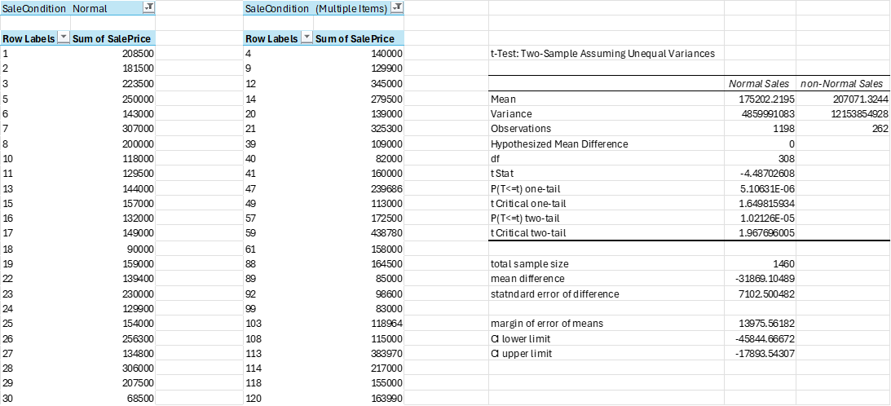
ANALYSIS OF SALE TYPE
(The null hypothesis is rejected)
Conclusion:
There is a significant difference (good or bad) between the pricing of houses based on the type of sale.

Slide 6
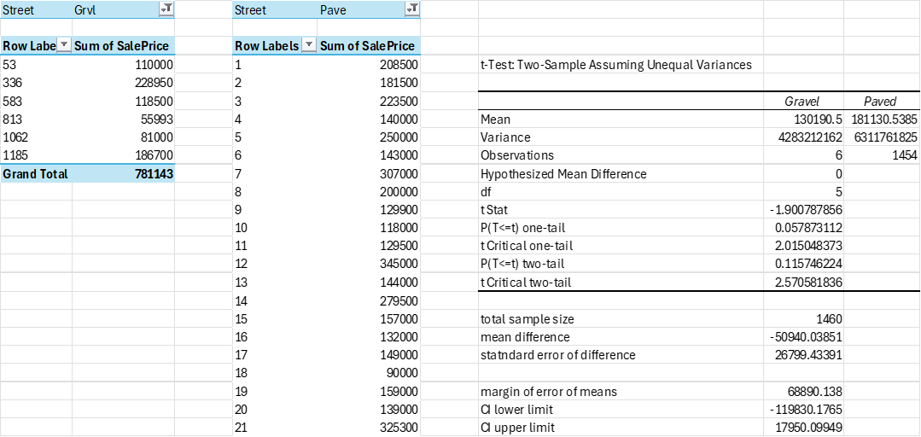
ANALYSIS OF ROAD TYPE
(The null hypothesis is not rejected)
Conclusion:
There is not significant difference between the pricing of houses based on the type of road the house is on

Slide 7
FINAL MESSAGE AND RECOMMENDATIONS
The statistical analyses showed that the sale type is a good indicator of average home pricing, while road type does not.
1. Sale type does have a significant effect on home prices
2. Road type does not have a significant impact on home prices
Recommendation:
Using the sale type of homes to determine mortgaged backed investments
For reference, analysis workbook is here.

Slide 8
FINAL TIPS & TAKEAWAYS
Consistent rehearsal
Strengthen your familiarity
Refine delivery style
Pacing, tone, and emphasis
Timing and transitions
Aim for seamless, professional delivery
Practice audience
Enlist colleagues to listen & provide feedback
Seek feedback
Reflect on performance
Explore new techniques
Set personal goals
Iterate and adapt

Slide 9
THANK YOU
Dannie Patterson

